Slide 1
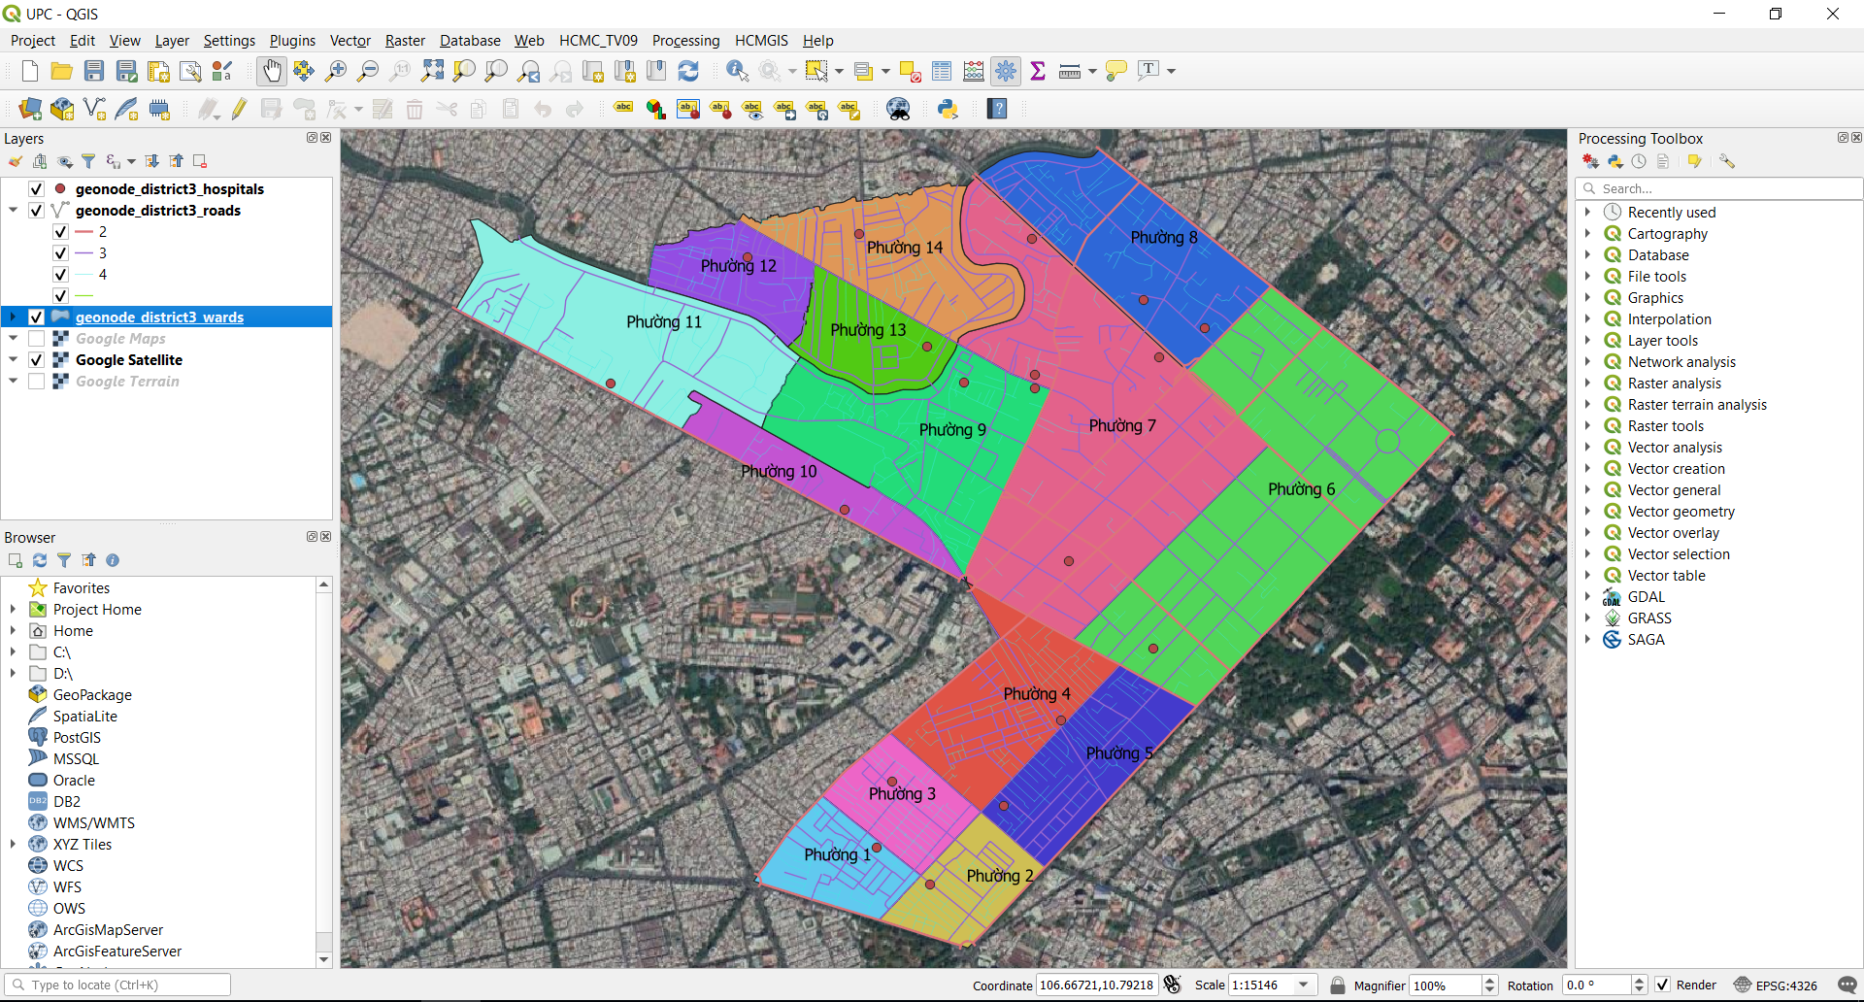
Unit 3: Coordinate Reference System

Slide 2
Coordinate Reference System
Useful terms: Geoid, Ellipsoid, Datum, EPSG...
Coordinate systems: Geographic Coordinate System, Projected Coordinate System
VN-2000 - WGS84 CRS transfer for each province in AutoCAD Civil 3D

Slide 3
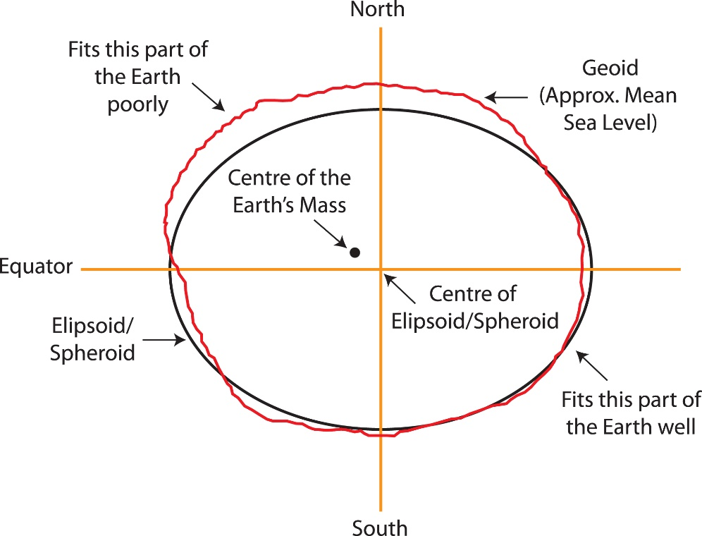
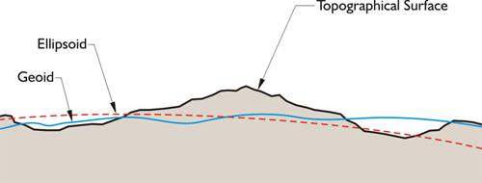
Coordinate Reference System
Earth Surface: too complex to be useful as a reference for measurement.
Geoid, Ellipsoid: approximation of the surface of the earth

Slide 4
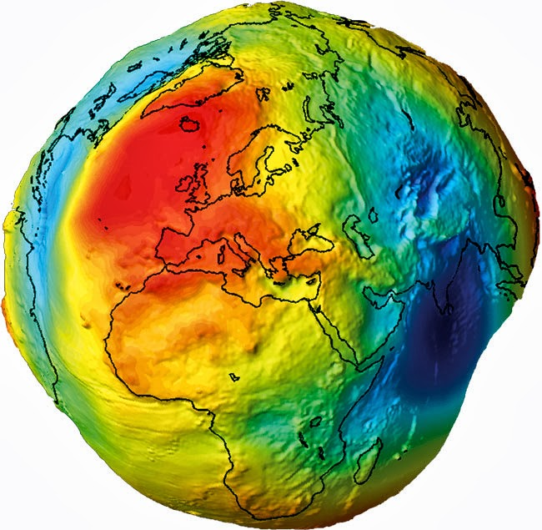
Coordinate Reference System
Geoid: The surface of the earth's gravity field, which is approximately the same as mean sea level.
The geoid is a representation of the surface of the earth that it would assume, if the sea covered the earth.
Perpendicular to the direction of gravity pull
The mass of the Earth is not uniform + the magnitude of gravity varies → the shape of the geoid is irregular.

Slide 5
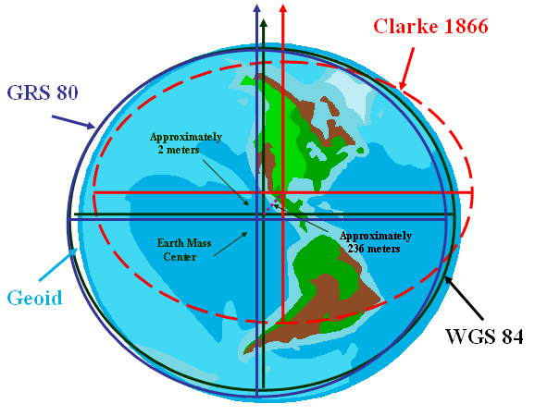
Coordinate Reference System
Ellipsoid (Spheroid): To simplify the Geoid model
Three-dimensional shape created from a two-dimensional ellipse
Various spheroids or ellipsoids have been devised: Clarke_1866, GRS_1980, WGS_1984

Slide 6
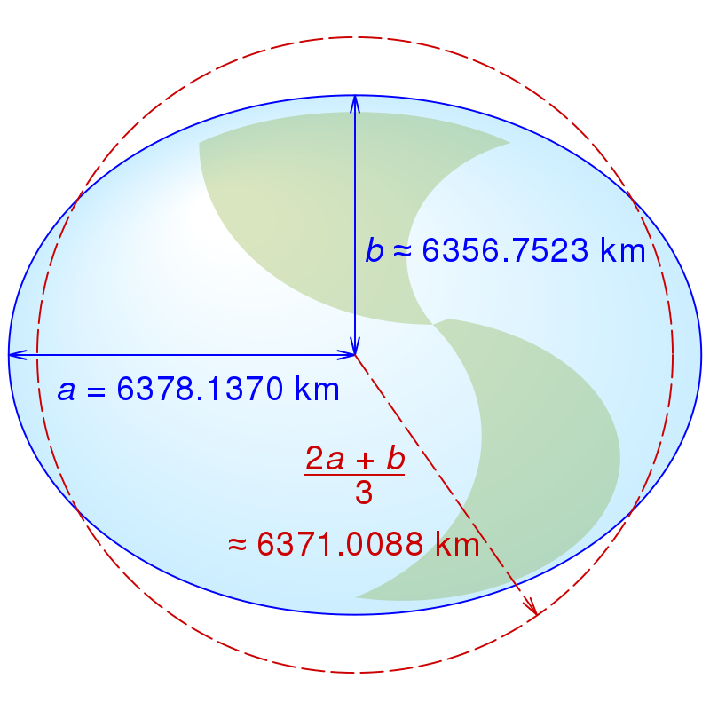
Coordinate Reference System
WGS84 Ellipsoid (World Geodetic System 1984):
Origin is at the Earth’s center of mass (geocentric)
Used for the NAVSTAR GPS satellites
Parameter | Notation | Value
Semi-major Axis | a | 6 378 137 m
Semi-minor Axis | b | ≈ 6 356 752 m
Flattening Factor of the Earth | 1/f (f = (a-b)/a) | 298.257223563
Nominal Mean Angular Velocity | ω | 7292115 10⁻¹¹ rad/s
Geocentric Gravitational Constant | GM | 3986004.418 108 m3/s

Slide 7
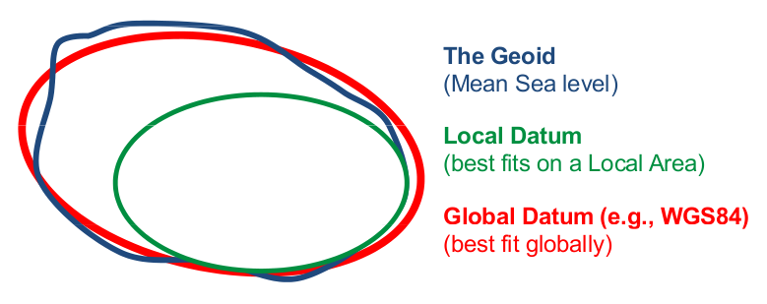
Coordinate Reference System
Datum:
Built on top of the selected ellipsoid
Consists of a series of numbers that define the shape and size of the ellipsoid and it's orientation in space
A datum is chosen to give the best possible fit to the true shape of the Earth.
There are a large number of datums in use

Slide 8
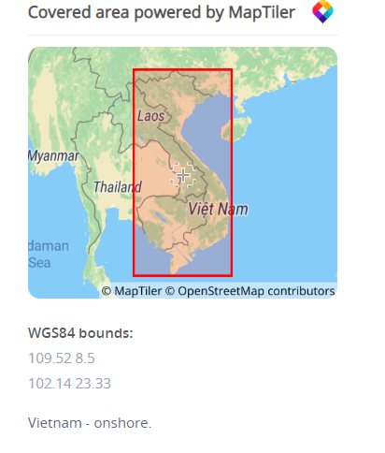
Coordinate Reference System
Vietnam 2000 Datum:
Ellipsoid: WGS 84
Prime meridian: Greenwich
Degree from Greenwich: 0
Data source: OGP
Information source: General Director of Land Administration.
Revision date: 2011-01-25
Scope: Geodetic survey, topographic mapping, engineering survey.
Remarks: Replaces Hanoi 1972.
Area of use: Vietnam - onshore.

Slide 9
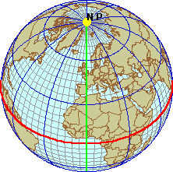
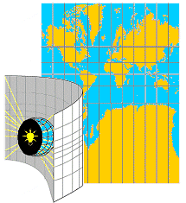
Coordinate Reference System
Coordinate Systems: Geographic vs. Projected
Geographic Coordinate Systems (GCS)
Location measured from curved surface of the earth
Measurement units latitude and longitude
Degrees-minutes-seconds (DMS)
Decimal degrees (DD) or radians (rad)
Projected Coordinate Systems (PCS)
Flat surface
Units can be in meters, feet, inches
Distortions will occur, except for very fine scale maps

Slide 10
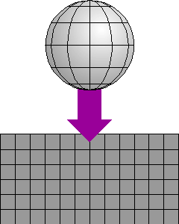
Map Projection
Map projection:
The Earth is curved and maps are flat
A map projection uses mathematical formulas to relate spherical coordinates on the globe to flat, planar coordinates.
Wide variety of projections possible
Each projection will create a different type of distortion (shape, area, distance, or direction)
One map projection might be used for large-scale data in a limited area, while another is used for a small-scale map of the world

Slide 11
Map Projection
Map projection:
Sets of mathematical equations that convert coordinates from one system to another
input output
unprojected projected
angles (lat/long) Cartesian coordinates

Slide 12
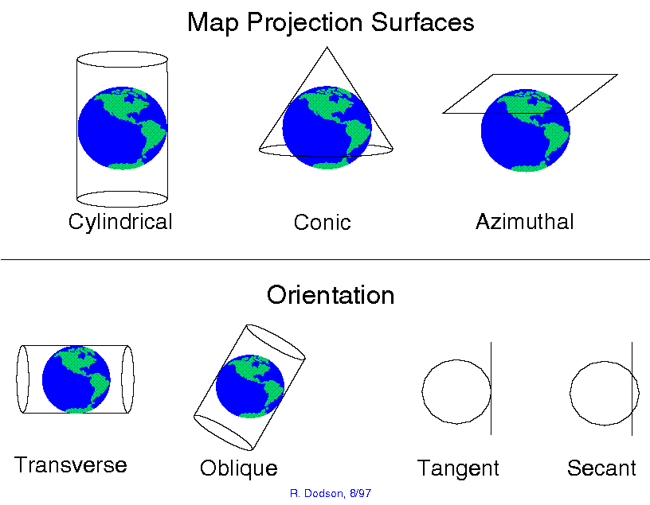
Map Projection
Classification of Map projections:

Slide 13
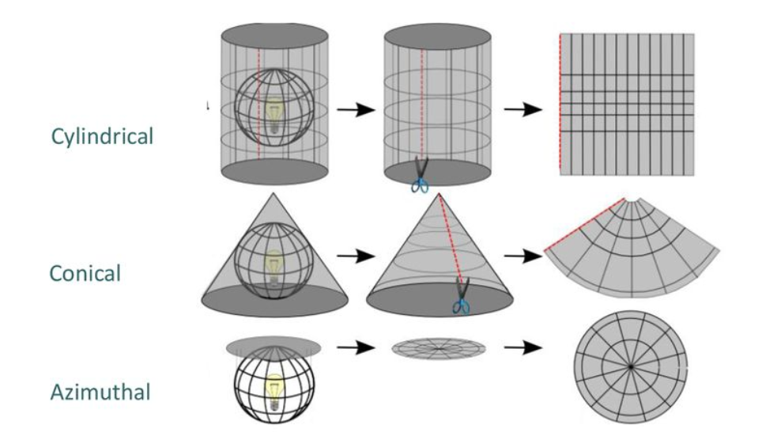
Map Projection
Classification of Map projections:

Slide 14
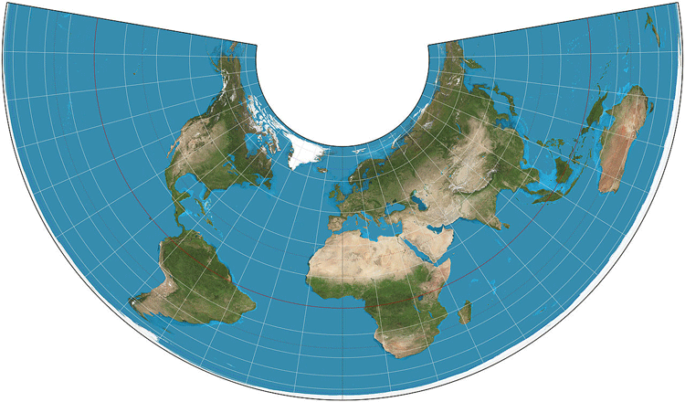
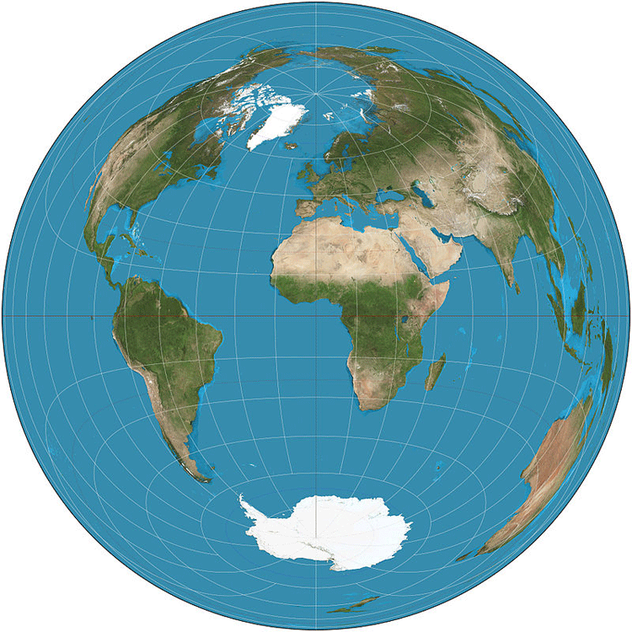
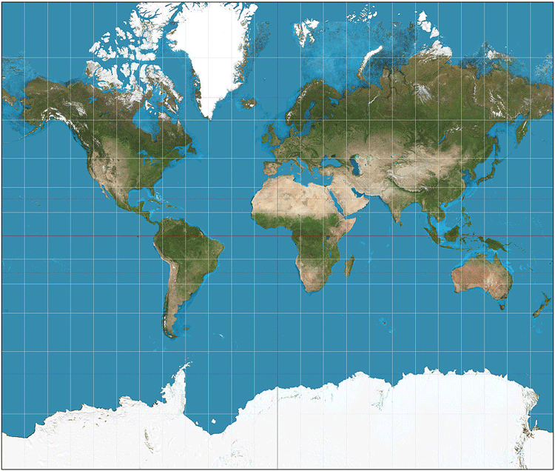
Map Projection
Classification of Map projections:
CONIC: Alber Projection
CYLINDRICAL: Mercator PROJECTION
Azimuthal: LAMBERT AZIMUTHAL
EQUAL-AREA PROJECTION

Slide 15
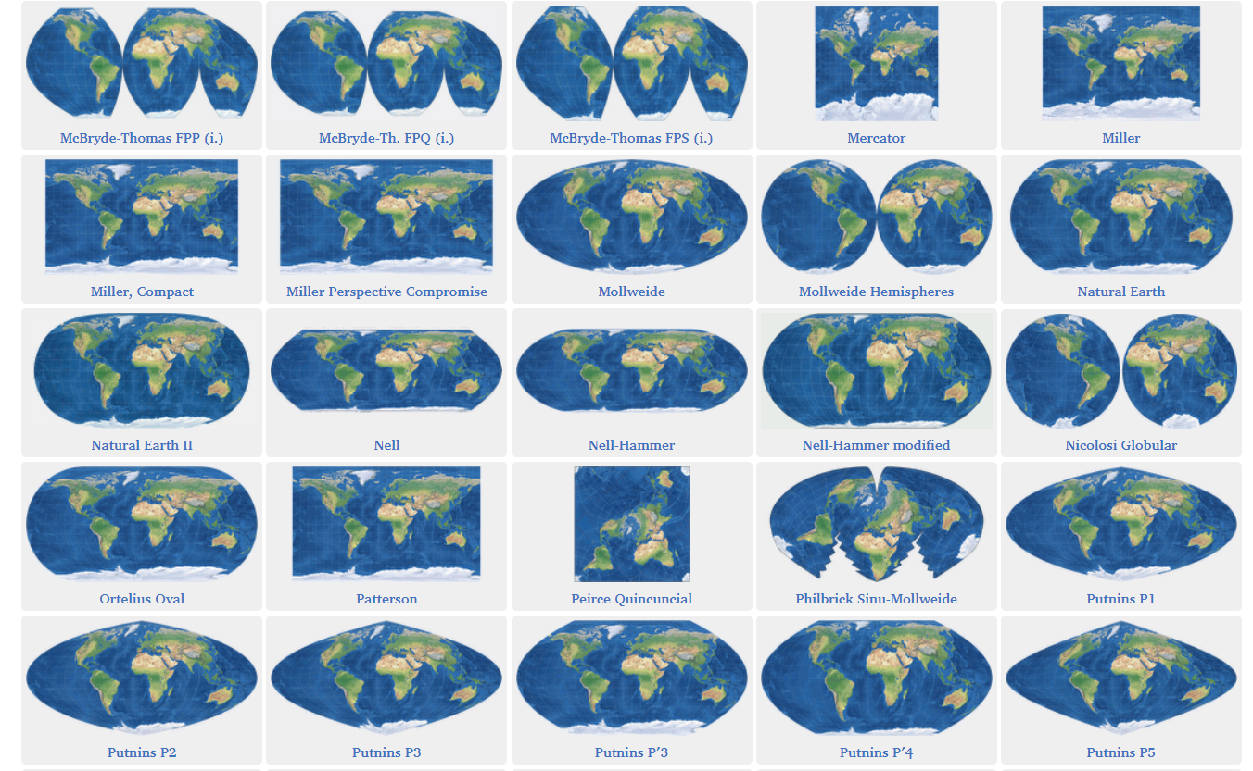
Map Projection
Map projections:
Over 200 of Map projections (https://map-projections.net/imglist.php)

Slide 16
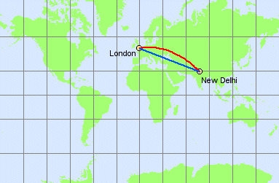
Map Projection
Map projections:
Each projection preserves a particular relationship or characteristic:
Equal-Area: preserves the size of feature
Conformal: preserves the shape of feature (UTM)
Equidistant: preserves the distance between two features
True Direction (Azimuthal): preserves the compass direction between 2 features (great circle distance)
A map cannot be at the same time equal-area, conformal and/ or equidistant
A Map projection is to be chosen based on the needs

Slide 17
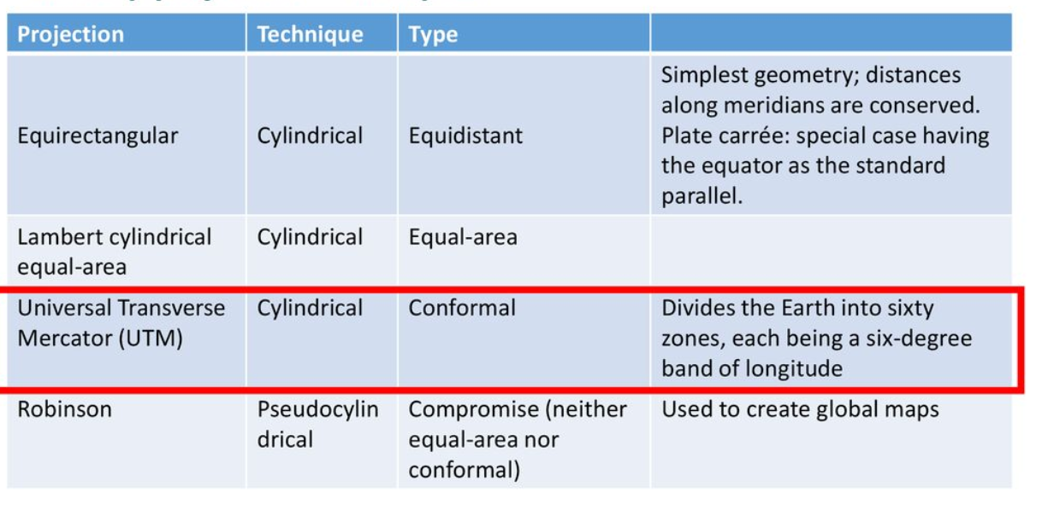
Map Projection
Map projections:

Slide 18
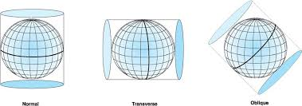
Map Projection
UTM (Universal Transverse Mercator)
The UTM projection is an adaptation of the standard Mercator projection which flips the cylinder 90 degrees (transverse).
The UTM projection flattens the sphere 60 times by shifting the cylinder central meridian 6° for each zone.
The UTM is horrible for small-scale (less-detailed) maps like world atlases and perfect for mapping narrow regions

Slide 19
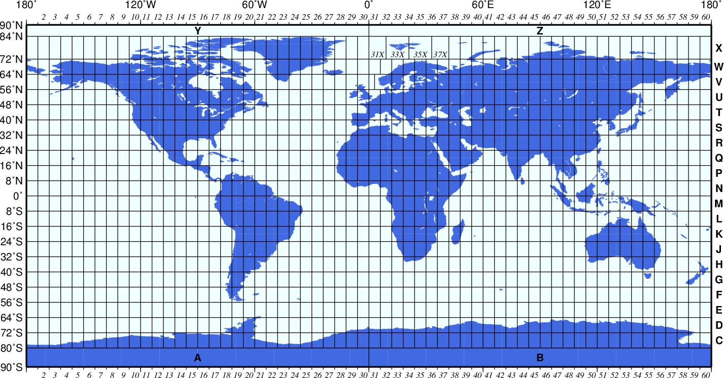
UTM Map projection:
UTM Map projection:
UTM divides the earth into 60 zones each 6 degrees of longitude wide.

Slide 20
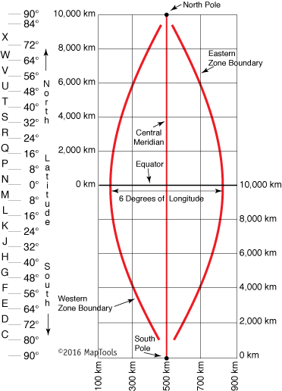
Coordinate Reference System
UTM Map projection:
The UTM system divides the Earth into 60 zones, each 6° of longitude in width.
A square grid is superimposed on each zone. It's aligned so that vertical grid lines are parallel to the center of the zone (called the central meridian)
A single grid zone measures about 20,000km tall and only about 700km wide.
UTM grid coordinates are expressed as a distance in meters to the east, referred to as the "easting", and a distance in meters to the north, referred to as the "northing".

Slide 21
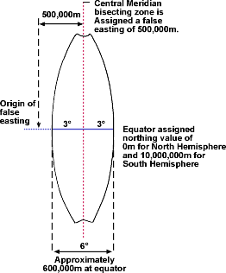
Coordinate Reference System
False easting is a linear value applied to the origin of the x coordinates.
False northing is a linear value applied to the origin of the y coordinates.
→ False easting and northing values are usually applied to ensure that all x and y values are positive.

Slide 22
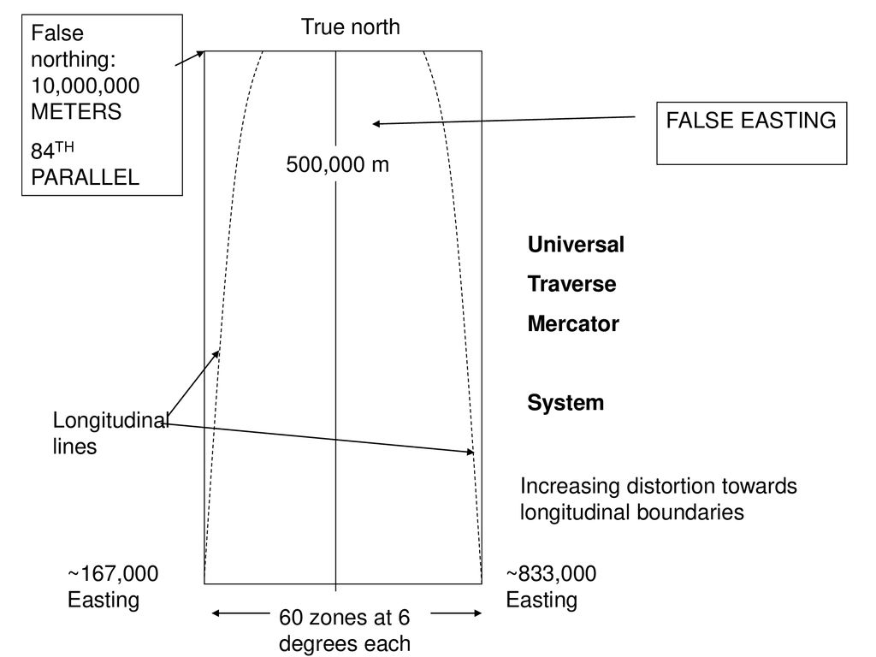
Coordinate Reference System
False Easting:
False easting (500,000) is given to the central meridian in each zone to prevent the use of negative values.
False Northing
False Northing (10,000,000) are added to the South of the Equator to avoid negative values

Slide 23
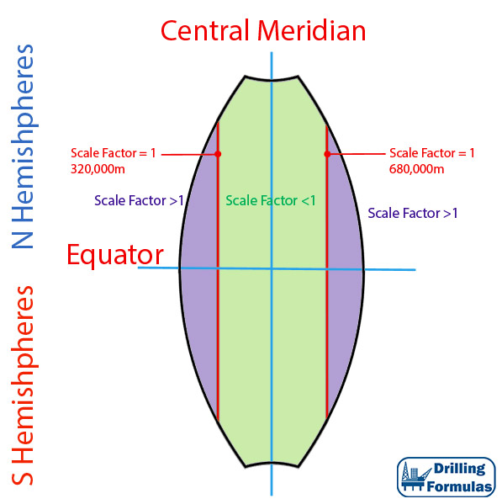
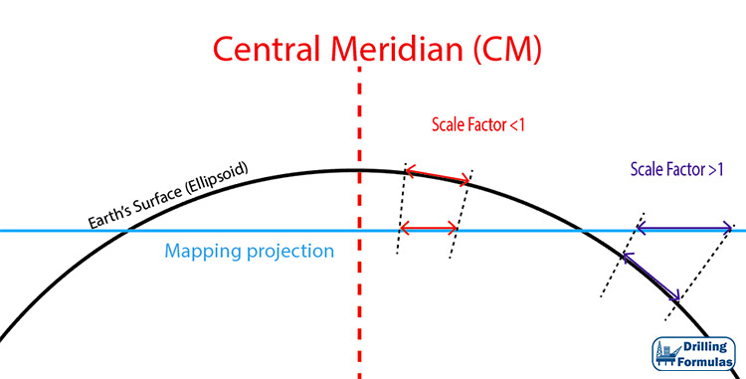
UTM Projection
Scale factor:
For UTM (6 degree zones), the central meridian (CM) has a scale factor of 0.9996
True Distance (m) = Map Distance ÷ scale factor
The scale factor reduces the overall distortion of the projection in the area of interest.

Slide 24
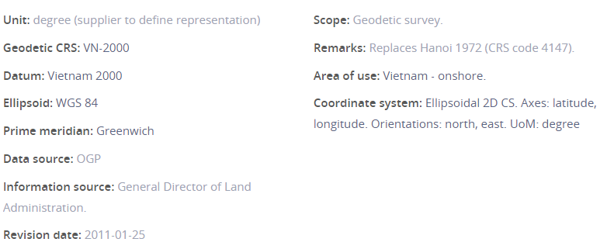
Coordinate Reference System
EPSG.io: Coordinate Systems Worldwide
VN-2000:
+proj=longlat +ellps=WGS84 +towgs84=-192.873,-39.382,-111.202,-0.00205,-0.0005,0.00335,0.0188 +no_defs

Slide 25
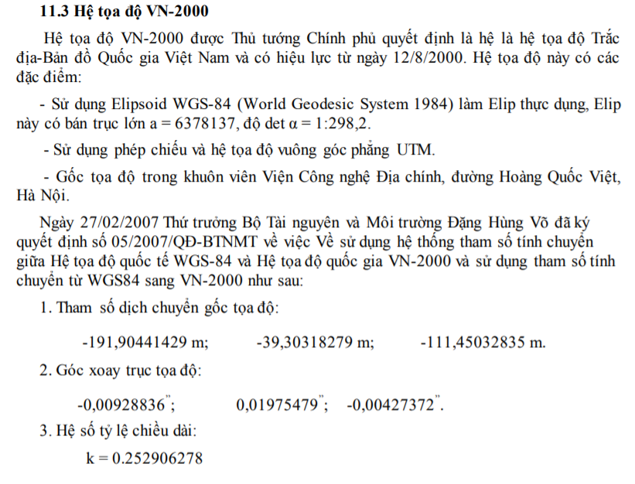
Coordinate Reference System

Slide 26
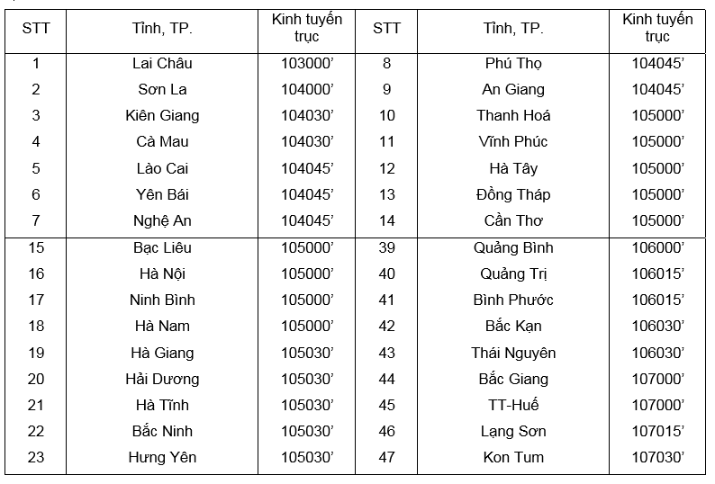
Coordinate Reference System

Slide 27
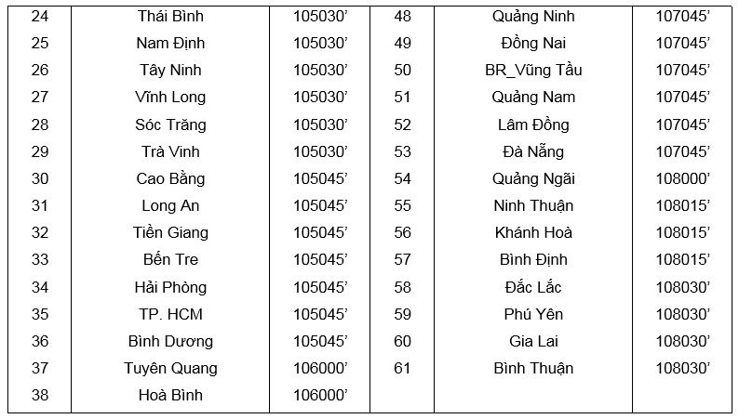
Coordinate Reference System

Slide 28
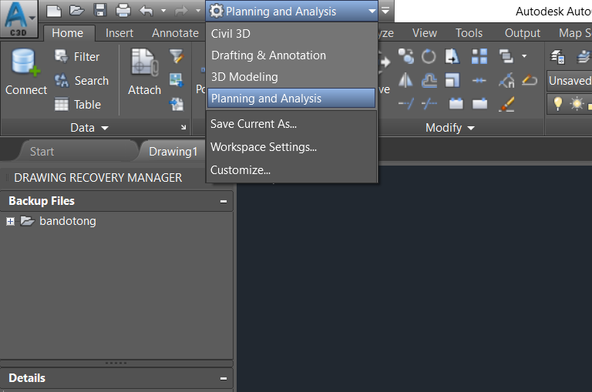
VN-2000 to WGS84 in AutoCAD Civil 3D
Create Coordinate system
Choose Planning and Analysis Workspace

Slide 29
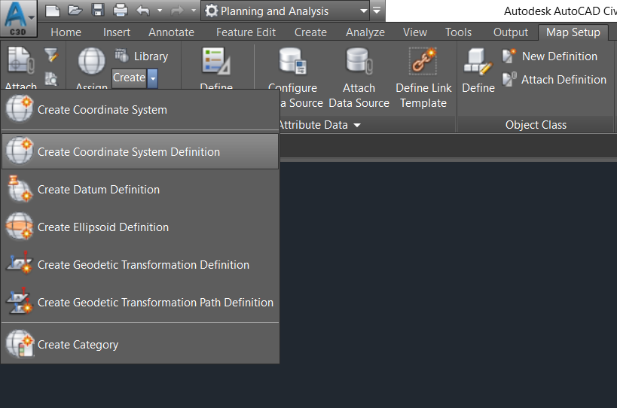
VN-2000 to WGS84 in AutoCAD Civil 3D
Create Coordinate system
In Map Setup → Create Coordinate System Definition

Slide 30
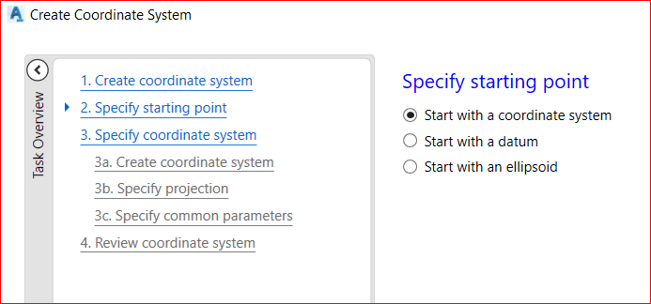
VN-2000 to WGS84 in AutoCAD Civil 3D
Create Coordinate system
Start with a coordinate system

Slide 31
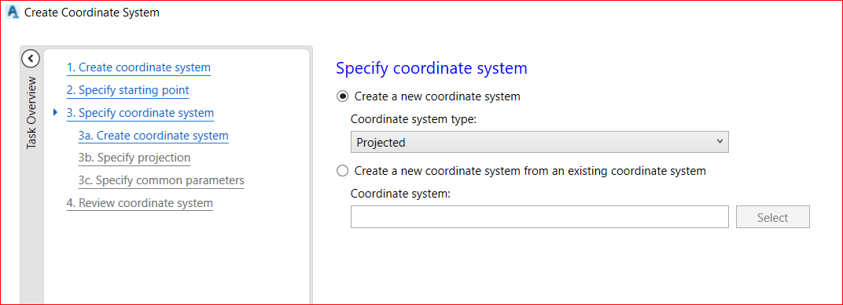
VN-2000 to WGS84 in AutoCAD Civil 3D
Create Coordinate system
Create a new Coordinate System with Projected type

Slide 32
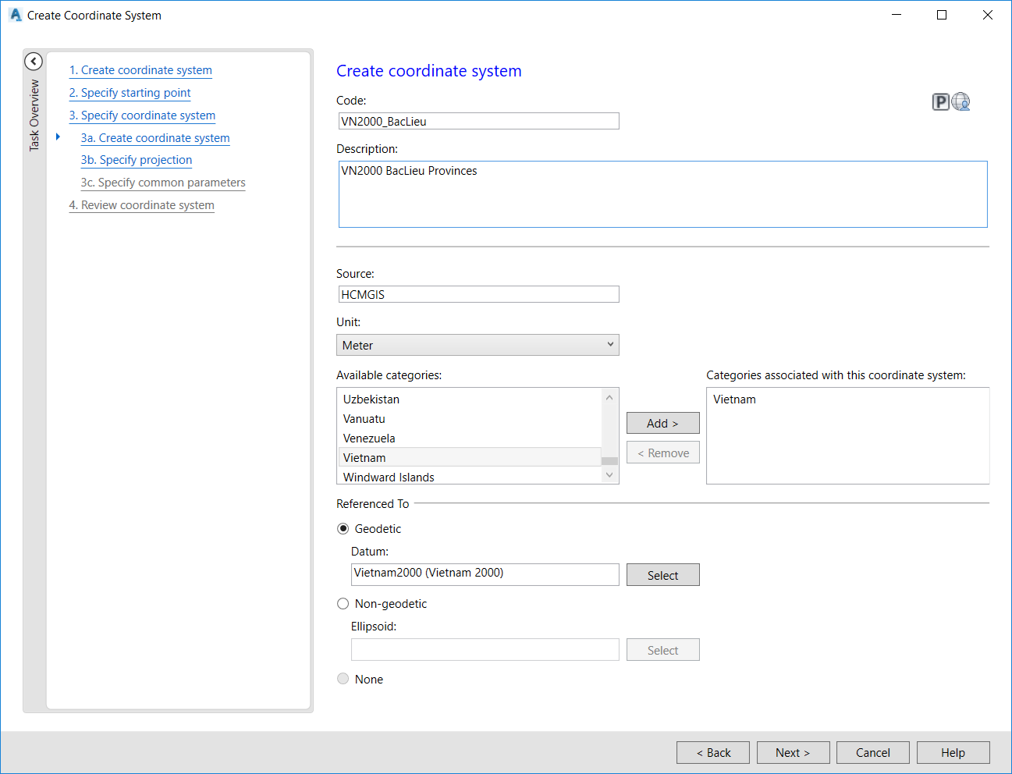
VN-2000 to WGS84 in AutoCAD Civil 3D
Create Coordinate system
Input parameters:
Code: Appropriate Name
Description: Appropriate Desc
Source: Author’s name
Unit: Meter
Available Categories: Vietnam→ Add
Geodetic → Select Vietnam 2000

Slide 33
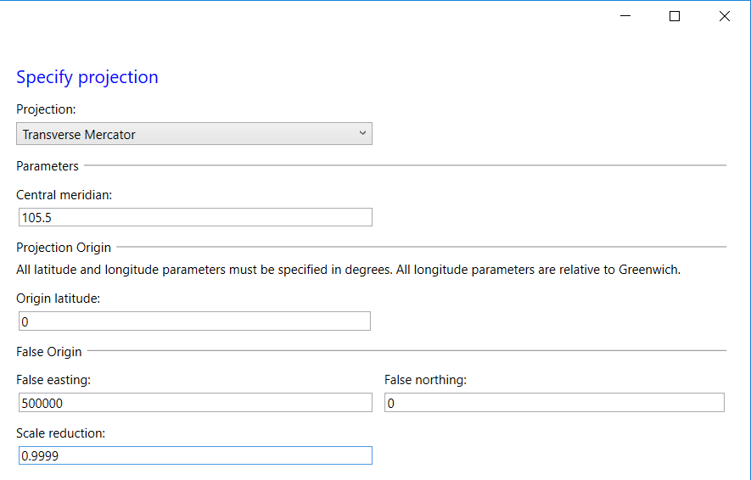
VN-2000 to WGS84 in AutoCAD Civil 3D
Create Coordinate system
Input parameters:
Central medidian:105 (for Bac Lieu Province)
False easting: 500000
Scale reduction: 0.9999 (for Cadastral map with 3 degrees zone width of)

Slide 34
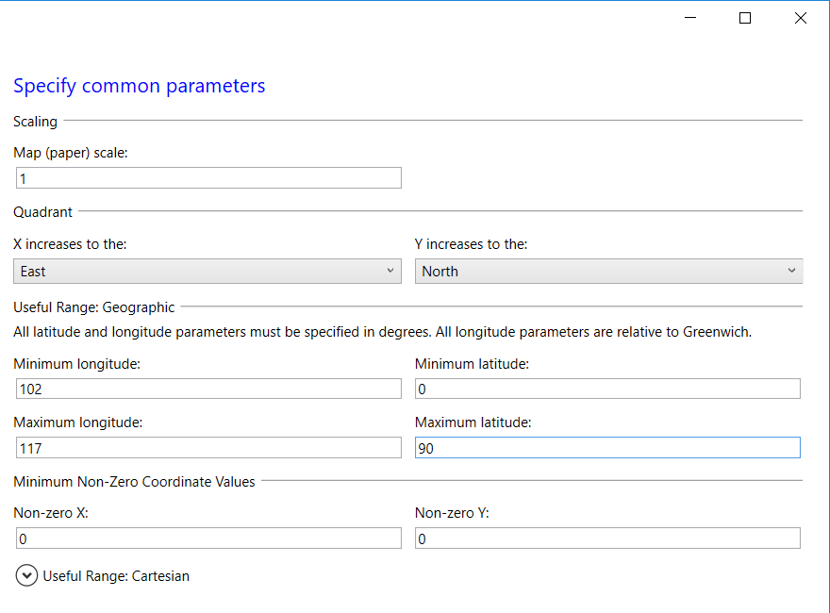
VN-2000 to WGS84 in AutoCAD Civil 3D
Create Coordinate system
Input parameters:
Min Longitude: 102
Max longitude: 117
Min Latitude: 0
Max Latitude: 90

Slide 35
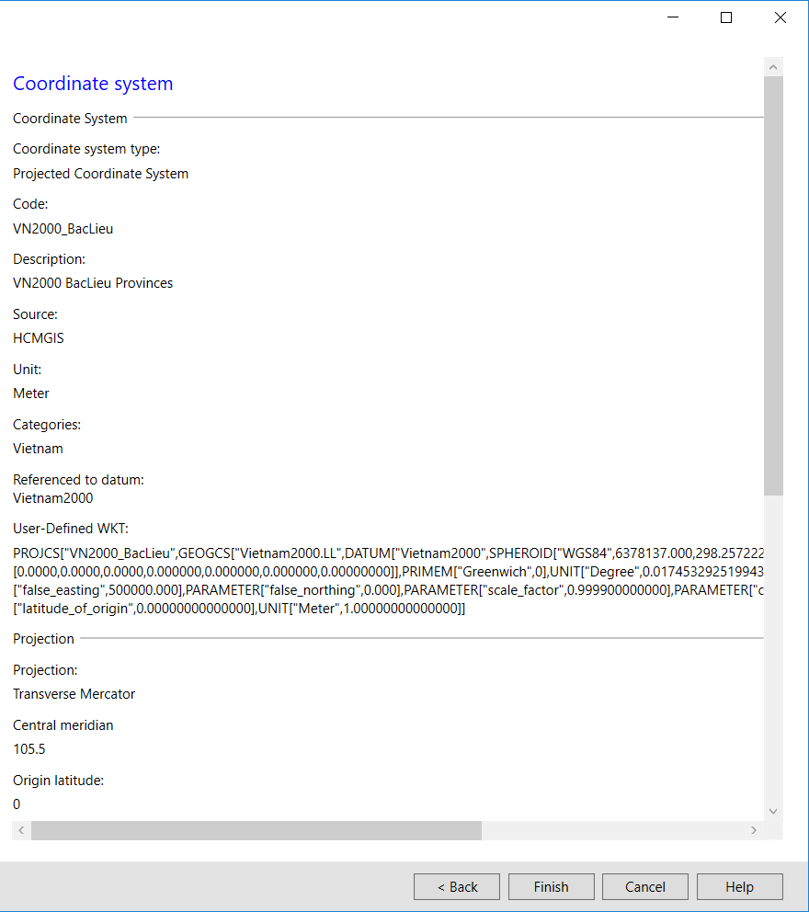
VN-2000 to WGS84 in AutoCAD Civil 3D
Create Coordinate system
Finish!

Slide 36
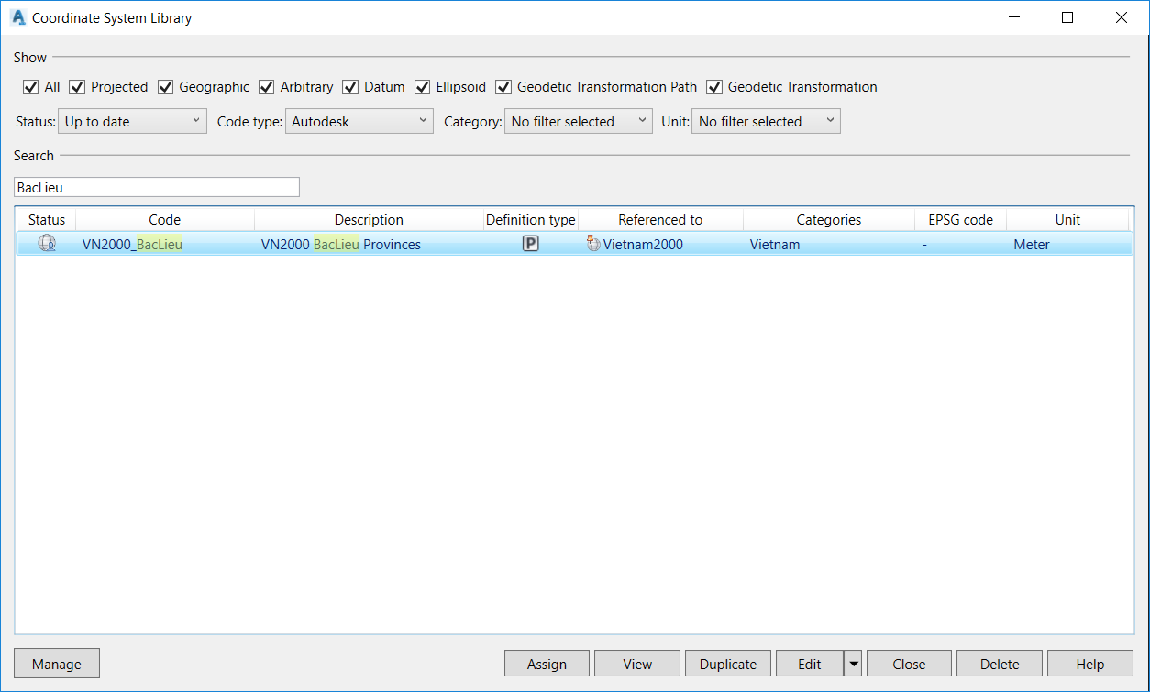
VN-2000 to WGS84 in AutoCAD Civil 3D
Create Coordinate system
Check again in the Library

Slide 37
VN-2000 to WGS84 in AutoCAD Civil 3D
Create Coordinate system for other Provinces based on VN200-BacLieu
Go to Library and Search BacLieu

Slide 38
VN-2000 to WGS84 in AutoCAD Civil 3D
Create Coordinate system for other Provinces based on VN200-BacLieu
Go to Library and Search BacLieu: Duplicate and Edit

Slide 39
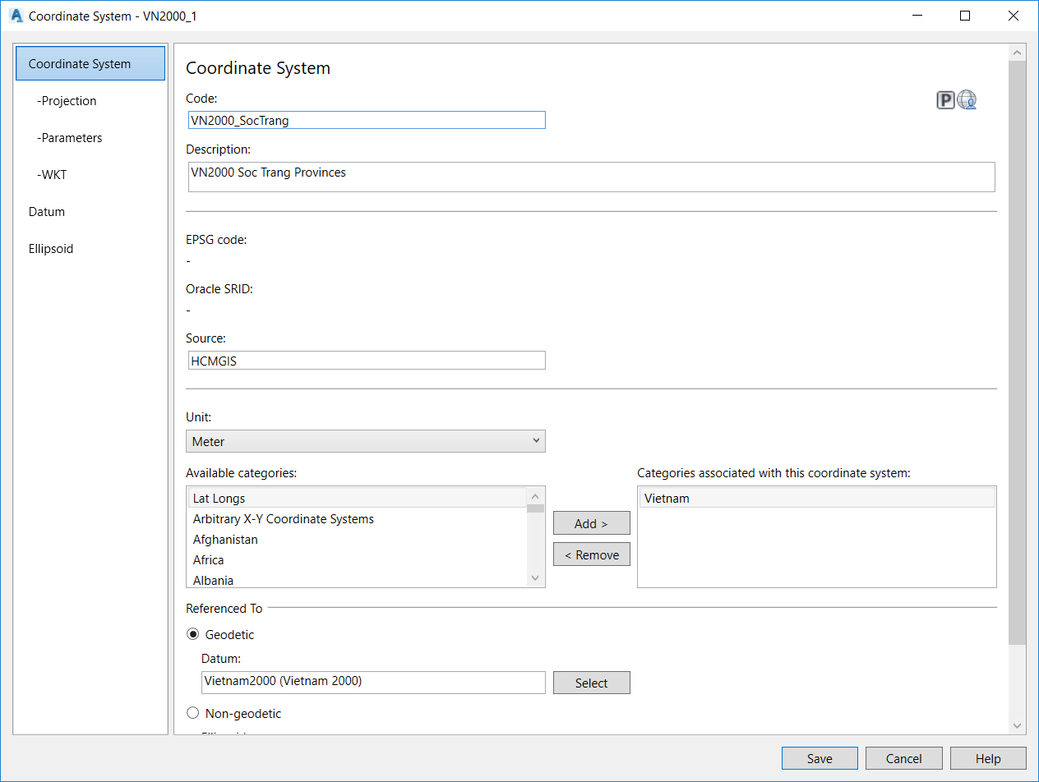
VN-2000 to WGS84 in AutoCAD Civil 3D
Create Coordinate system for other Provinces based on VN200-BacLieu
Change Central Meridian for each Province

Slide 40
VN-2000 to WGS84 in AutoCAD Civil 3D
Create Coordinate system for other Provinces based on VN200-BacLieu
Change Central Meridian for each Province

Slide 41
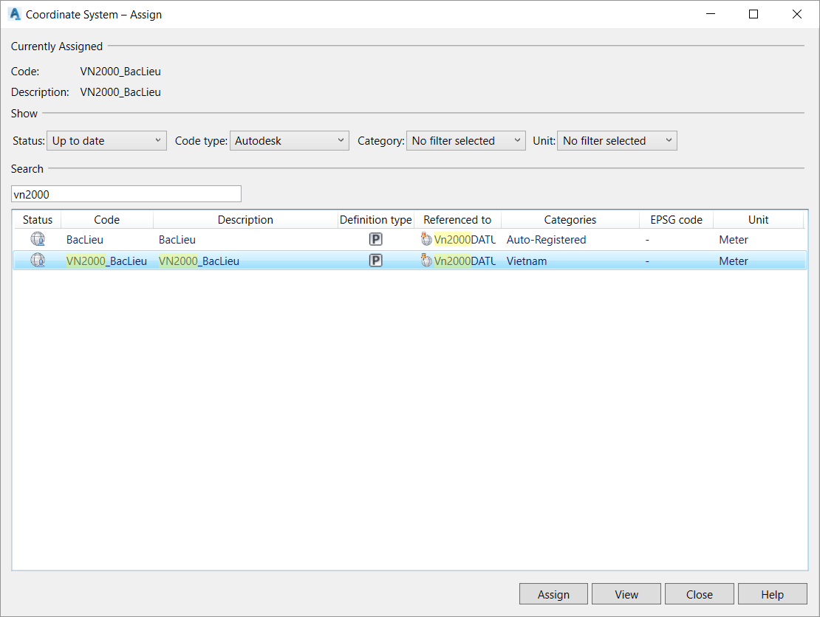
VN-2000 to WGS84 in AutoCAD Civil 3D
Assign CRS for VN-2000 AutoCAD file:
In Map Setup menu → Assign

Slide 42
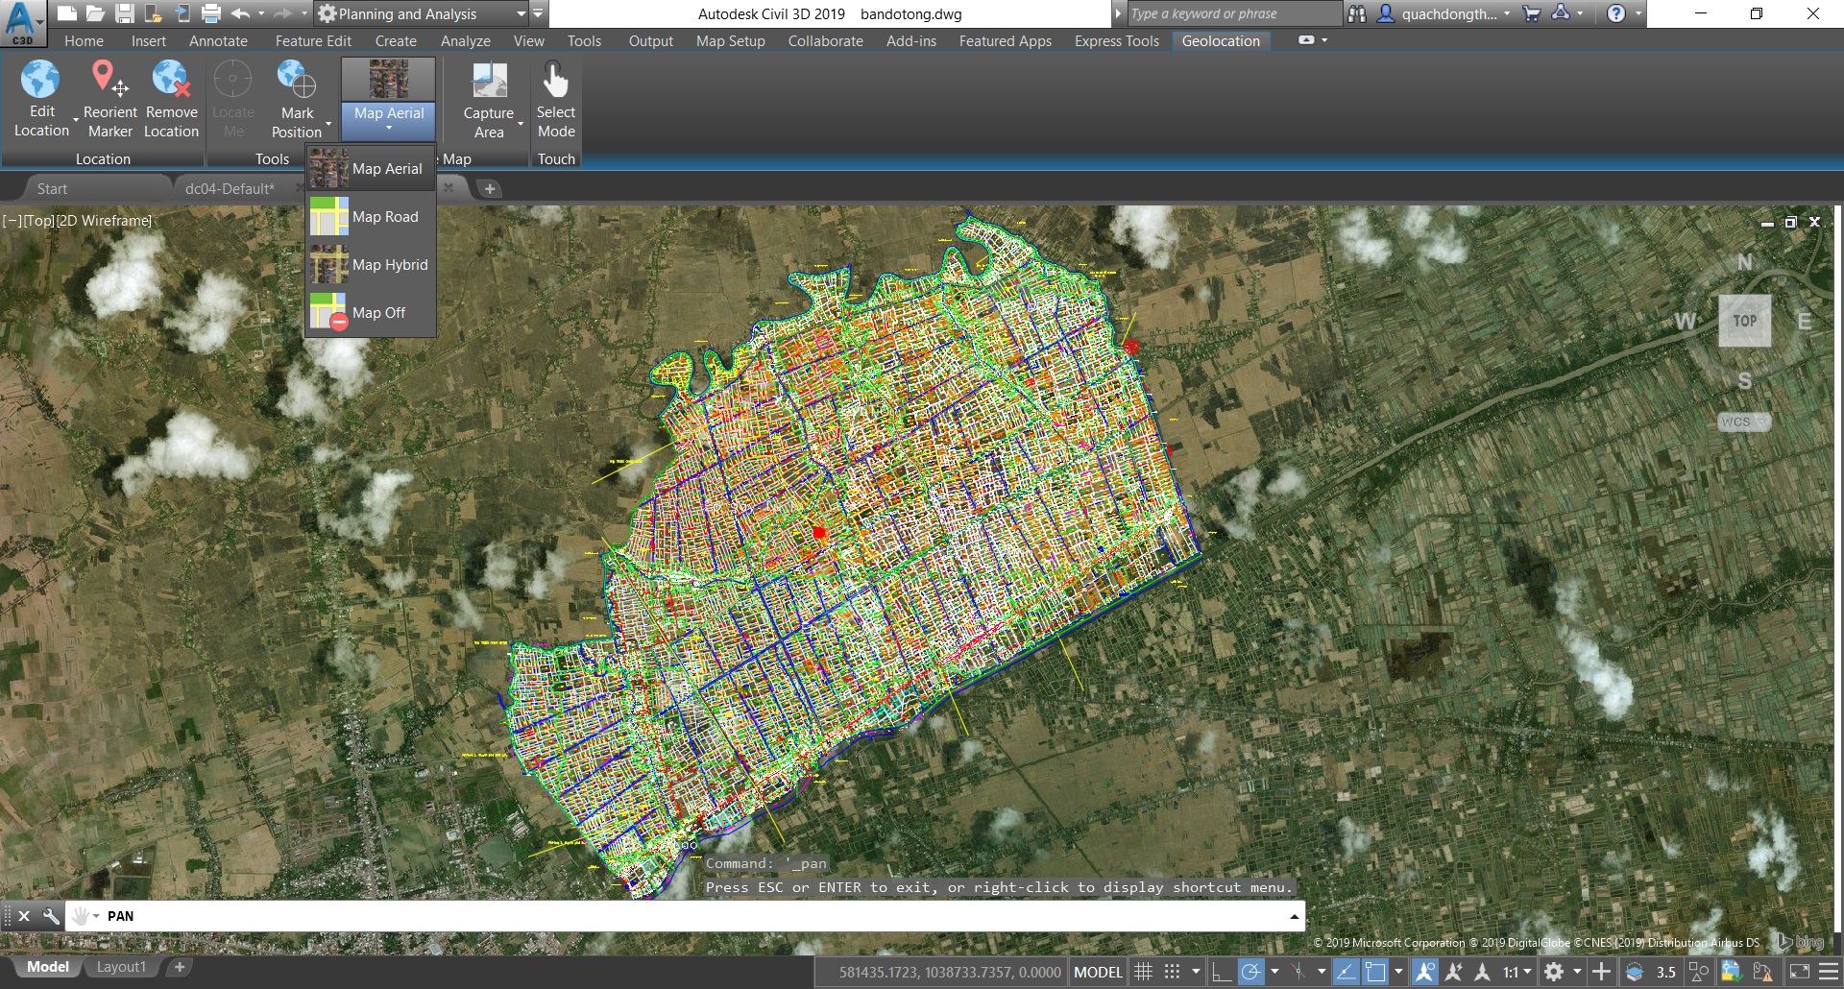
VN-2000 to WGS84 in AutoCAD Civil 3D
Check the result: In Geolocation menu → Choose Basemap → Done

Slide 43
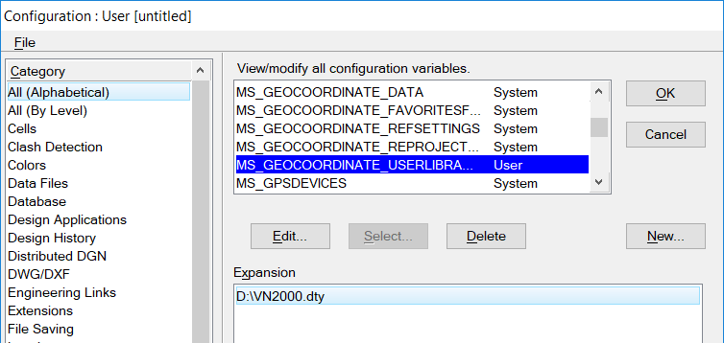
VN-2000 to WGS84 in Microstation
VN-2000 to WGS84 in MicroStation V8i
Download VN2000.dty from https://github.com/hcmgis/QGIS-Training/blob/master/VN2000.dty
Menu\Workspace\Configuration → All (Alphabetial)
New:
Variable: MS_GEOCOORDINATE_USERLIBRARIES
Value: VN2000.dty file path (D:\VN2000.dty)
Restart MicroStation

Slide 44
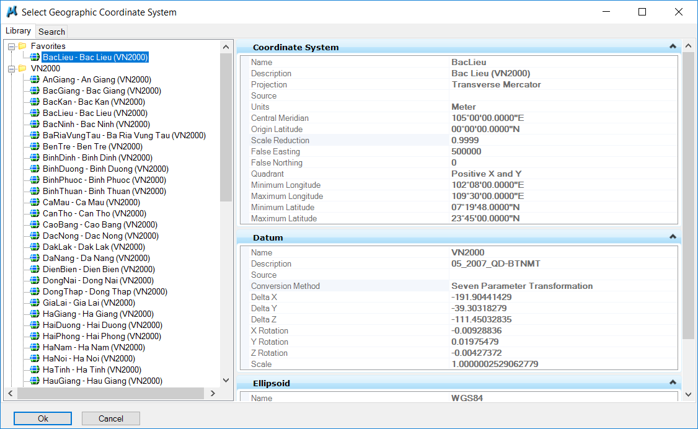
VN-2000 to WGS84 in Microstation
VN-2000 to WGS84 in MicroStation V8i
Tool\Geographic\Select Geographic Coordinate System → From library
Select appropriate VN2000 projection for each province
Export to KML and open in Google Earth

Slide 45
VN-2000 to WGS84 in QGIS
In QGIS: Settings →Custom projection
Bình Thuận Province:
+proj=tmerc +lat_0=0 +lon_0=108.5 +k=0.9999 +x_0=500000 +y_0=0 +ellps=WGS84 +towgs84=-191.9044129,-39.30318279,-111.45032835,-0.00928836, 0.01975479, -0.004274, 0.252906278 +units=m +no_defs

Slide 46

VN-2000 to WGS84 in AutoCAD Civil 3D
“On the fly” projection:
Like putting on a pair of glasses
You see the map differently, but the data have not changed

Slide 47
Keep Calm and enjoy Learning!

